Slide 1
Excess readmission ratio
Abdullah alluhidan

Slide 2
Novant health prince William medical center
Goals: reduce the Excess readmission ratio of HIP KNEE because It is higher than national median.

Slide 3
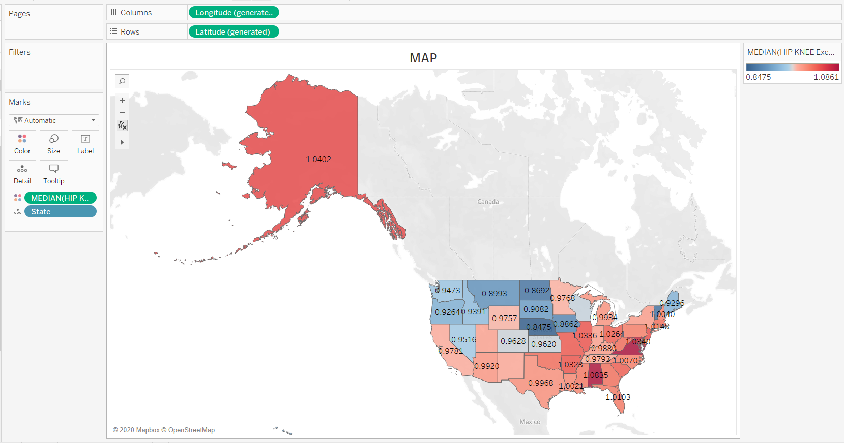

map

Slide 4
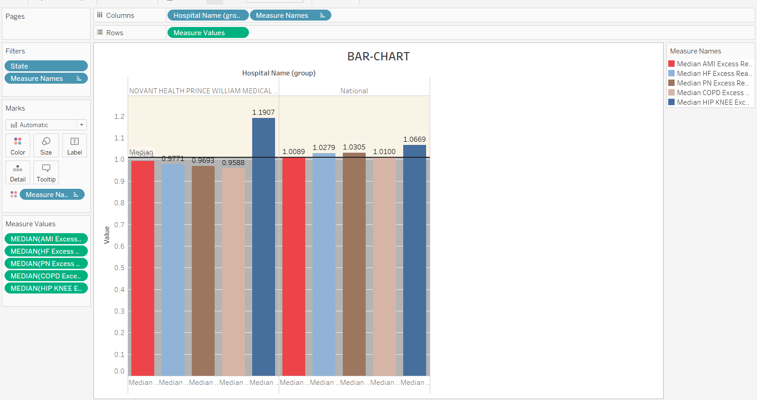
BAR-CHART.

Slide 5
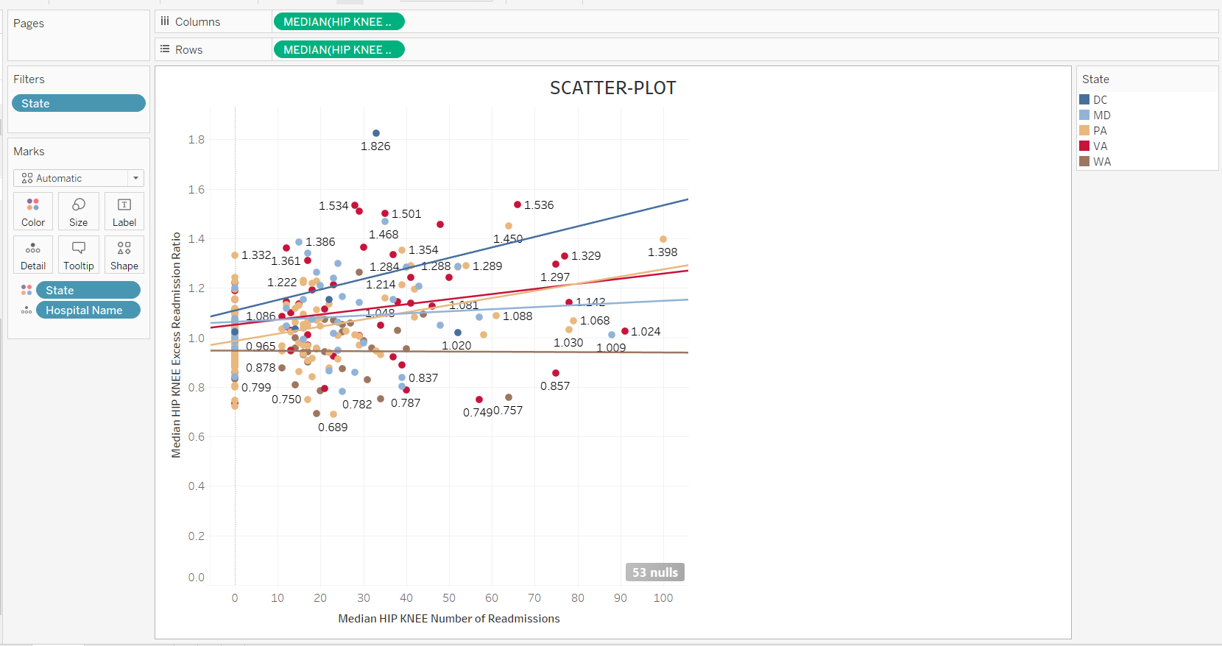
SCATTER-PLOT

Slide 6
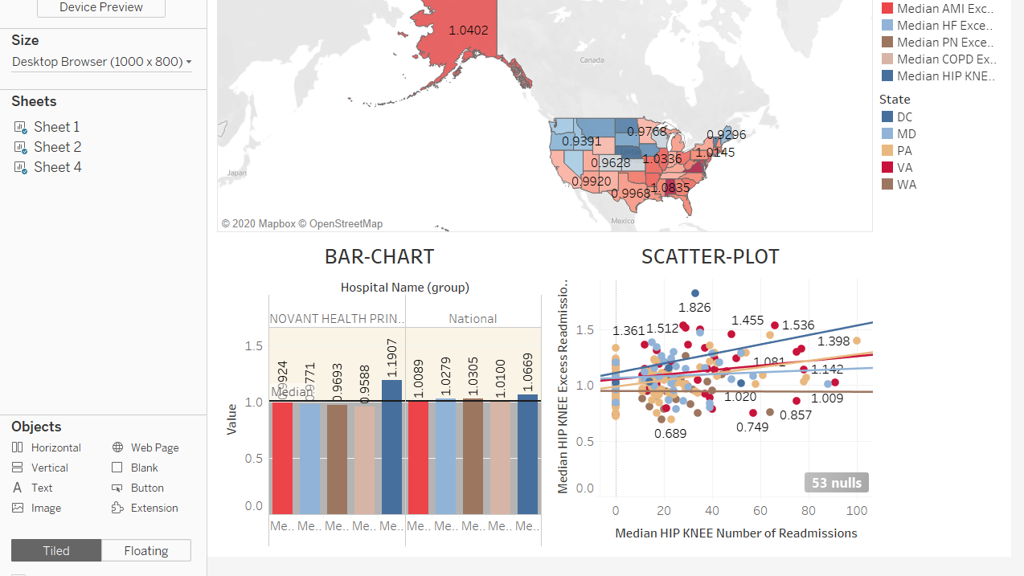
DASHBOARD

Slide 7
DESCRIBTION:
CHART BAR SHOWS A HIGHER HIP KNEE Excess readmission ratio THAN THE NATIONAL RATIO.
MAP INDICATES THAT VIRGINIA STATE HAS THE HIGHEST HIP KNEE Excess readmission ratio.

Slide 8
CONCLUSION:
HIP KNEE is a problem not only to my hospital but to VIRGINIA state it self.
Looking to the MAP could help us understand that the strategy we are using here in VIRGINIA is not accurate or does not help the patient. So, many patient coming back.
We have to help VIRGINIA to improve the HIP KNEE Excess readmission ratio.

